Slide 1
Deep Learning and Black-Litterman for Portfolio Optimization
Nigel Saurino
Tejus Setlur
Supervisor: Dr. Daniel Totouom
1 2 . 10 . 2 2

Slide 2
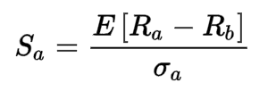
Introduction
P A R T 0 1
Portfolio optimization is the method of selecting the best portfolio which gives back the most profitable rate of return for each unit of risk taken by the investors.
The Sharpe ratio compares the return of an investment with its risk.

Slide 3
Introduction
An exchange-traded fund (ETF) is a type of pooled investment security that operates much like a mutual fund.
Instead of choosing individual assets, Exchange-Traded Funds (ETFs) of market indices are selected to form a portfolio.
We use four market indices: US total stock index (VTI), US aggregate bond index (AGG), US commodity index (DBC) and Volatility Index (VIX).
We use different portfolio optimization techniques to choose the right combination of weights for these four indices.

Slide 4
Deep Learning Portfolio Optimization

Slide 5
Methodology - Deep Learning
Fully Convolutional Networks, or FCNs, are an architecture used mainly for semantic segmentation. They employ solely locally connected layers, such as convolution, pooling and upsampling.
A Convolutional Neural Network (CNN) is comprised of one or more convolutional layers (often with a subsampling step) and then followed by one or more fully connected layers as in a standard multilayer neural network.
Long Short-Term Memory (LSTM) networks are a type of recurrent neural network capable of learning order dependence in sequence prediction problems.

Slide 6
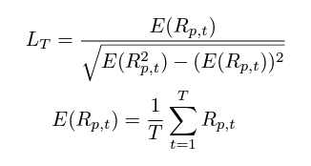

Methodology - Deep Learning
From the Sharpe Ratio we already discussed, we can maximize the objective function:

Slide 7



Methodology - Deep Learning
In our approach, a neural network f with parameters θ is adopted to model w_{i,t} for a long-only portfolio:
A long-only portfolio imposes constraints that require weights to be positive and summed to one, we use softmax outputs to fulfill these requirements
We use gradient ascent to maximise the Sharpe ratio.

Slide 8
Architecture
Our model consists of three main building blocks: input layer, neural layer and output layer.
Input Layer: The input features of one asset can be its past prices and returns with a dimension of (k,2) where k represents the lookback window
Neural Layer: LSTMs deliver the best performance for modelling daily financial data
The LSTM operates with a cell structure that has gate mechanisms to summarise and filter information from its long history

Slide 9
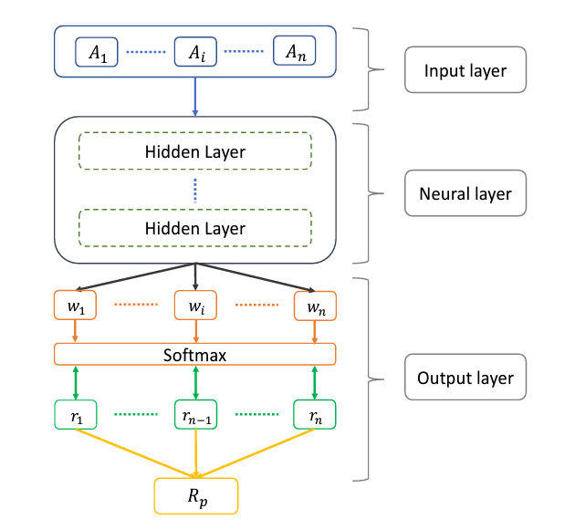
Architecture
Output Layer: we use the softmax activation function
We can derive the Sharpe ratio and calculate the gradients of the Sharpe ratio with respect to the model parameters and use gradient ascent to update the parameters

Slide 10
Black-Litterman Portfolio Optimization

Slide 11
Methodology
Black-Litterman is an adaptation of the classic mean-variance framework
B-L enables investors to combine their unique views regarding individual asset performance with the market equilibrium
B-L can be summarized into 5 key steps:
Find Risk Premia to demand from stocks in market portfolio
Adjust Risk Premia of individual stocks with our own views
Have mixed estimate of forward-looking returns
Perform classic mean-variance optimization to calculate weights for individual stocks in portfolio using the covariance matrix
End result is the set of expected returns of individual assets in the portfolio and their associated optimal portfolio weights

Slide 12
Methodology
Black-Litterman hinges on a few key terms:
Implied Excess Equilibrium Returns: Neutral starting point for B-L of the market return for the portfolio
Risk Aversion Coefficient λ: Excess return on the market divided by the variance of the market (i.e. the price of risk)
Covariance matrix (Σ) of the portfolio
Weight vector (w) of the portfolio
Views vector (Q) of investor outlook for each asset (can be relative or absolute view)
Link matrix (P) to link the views to assets in the portfolio
Uncertainty matrix (Ω) of our views
Scalar (𝜏): Set to 0.025 by B-L but often 1 is used

Slide 13
Methodology
Black-Litterman’s key formulas:
Start by calculating implied excess equilibrium returns (derivation of investor utility function):
Π = λ * Σ * w
Incorporate the Views Vector and Confidence in our views:
View confidence is Ω⁻¹ where: Ω = 𝜏 * P * Σ * P^{T}
B-L estimates excess returns (updated for the views) with a weighted average of Π and Q.
Weights of the function are our confidence in Π = 𝜏 * Σ⁻¹ and the confidence in Q times our link matrix to indicate which assets the views are about (P^{T} * Ω⁻¹)

Slide 14
Methodology
Black-Litterman’s key formulas (cont’d):
Taken together, second term of B-L:
(𝜏 * Σ⁻¹) * Π + (P^{T} * Ω⁻¹) * Q
Finally, B-L formula:
E[r] = [(𝜏 * Σ⁻¹) + (P^{T} * Ω⁻¹ * P)]*[(𝜏 * Σ⁻¹) * Π + (P^{T} * Ω⁻¹) * Q]
New weights are calculated by solving the unconstrained maximization problem: w = (λ * Σ)⁻¹ * E[r]
In summary, B-L can be viewed as the sum of two portfolios (the original market-cap weighted portfolio and the investor portfolio of long/short positions expressed as views)

Slide 15
Empirical Results
Implemented an LSTM model and B-L as a benchmark with the Sharpe ratio as our objective function
Used 2006 - 2011 as our training set and 2011 - 2020 as our test set
Test set included regime change and several market shocks including the taper tantrum, a low volatility environment, rising interest rates and a global pandemic
We used a rolling 50-day lookback of asset returns for our covariance matrix in B-L
Methodology for selective views vector for B-L posed a challenge

Slide 16
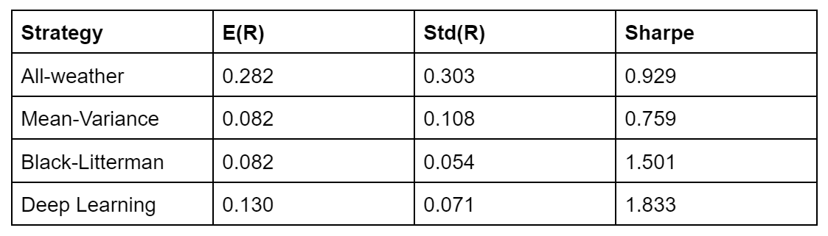
Analysis
The Sharpe ratio is a classic industry metric and offers important implications from a single value. In our analysis, you can see that the ratios of each allocation strategy have similar performance results for the years between 2011 and 2020.

Slide 17
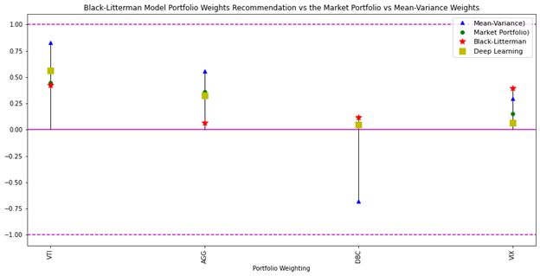
Analysis
At the end of our test set (May 2020) our final allocations were:

Slide 18
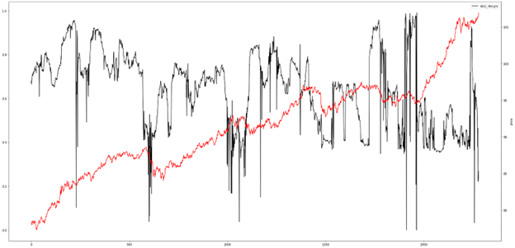
Analysis
We graphed our allocations against each ETF’s price over the test set to look for irregularities in the data set (AGG below for reference):

Slide 19
References
Zhang et al: https://arxiv.org/pdf/2005.13665.pdf
Idzorek:
https://people.duke.edu/~charvey/Teaching/BA453_2006/Idzorek_onBL.pdf
Totouom Slides

Slide 20
Thank you
Nigel Saurino
Tejus Setlur

